Slide 1
Optimizing High School Graduation Rates
Alyssa Newman, Collin Powell, Zane Showalter-Castorena

Slide 2
The View From 30k Feet
Deliverable: A customizable model which produces a strategy to optimize graduation rates for a particular school/district.
We’re presenting the model as a tool. Flexibility and user customization is as big a part of this deliverable as the optimal result.
The solution generated by this model is NOT designed to be the de-facto solution to the problem of low graduation rates. Rather, this model should be paired alongside a wholistic approach by the administration. People are not machines.

Slide 3
Chosen Variables For Our Model
Student teacher ratio
Average teacher Salary
Median house cost
Faculty turnover rate
Number of students in advanced classes
Demographic disparity between teachers and students
Male vs female teacher ratio
Number of students in special education

Slide 4

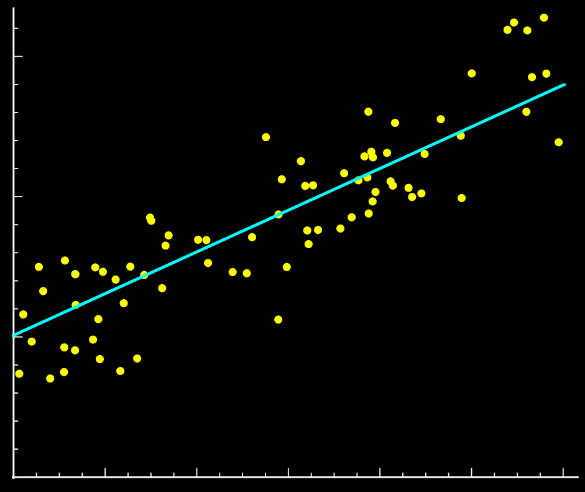
Regression And Optimization

Slide 5
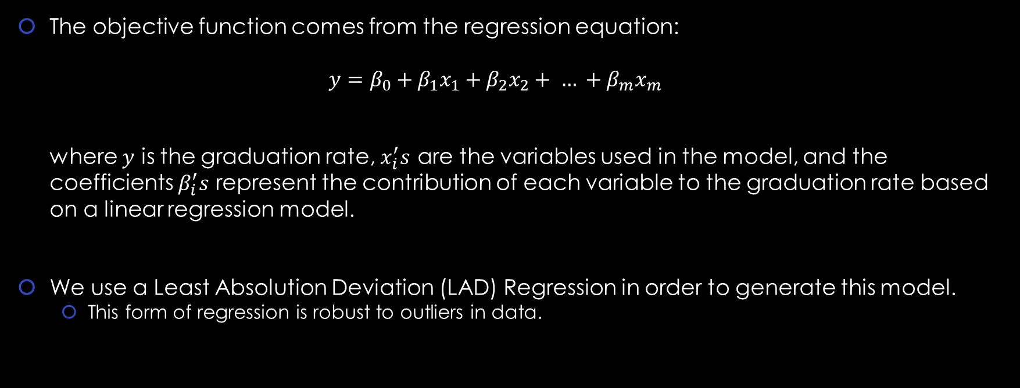
Linear Regression Model For Objective Function

Slide 6
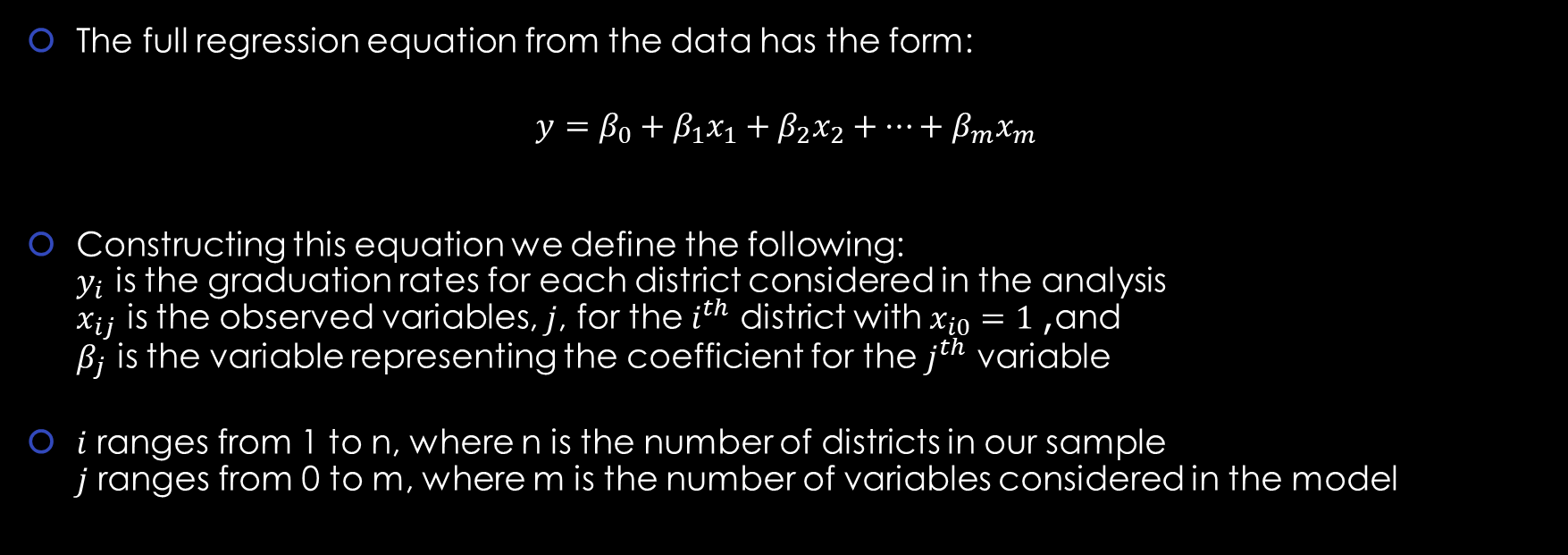
Construction Of The Objective Function

Slide 7



Construction Of The Objective Function
The LP then to generate this regression equation has the form:

Slide 8
Results of Regression
Actual objective funct
Interpret some of the coefficients
Def address the teacher salary

Slide 9
Assumed stuff about our ‘toy’ school

Slide 10
Constructed Constraints For Test Model
Budget, will be affected by:
Student teacher ratio, Teacher salary, Faculty turnover rate
Size of school, will be affected by :
Student teacher ratio, number of students in advanced classes, number of students is special education
Restrictions on:
Median home cost, Faculty turnover rate, number of students in advanced classes, Demographic disparity between teachers and students, Male vs Female teacher ration, number of students is special education

Slide 11
Budget constraint

Slide 12
Actual model
Variables are in terms of CHANGE

Slide 13
Dem results

Slide 14
Discuss implications of results
What actually shows

Slide 15
Holes in result/ needs more research
% male teachers, special ed

Slide 16
Limitations And Potential Extensions
Use for several different states
Compare different objective functions and different solutions for different states
Add more variables
Teacher experience, after school programs, parent education level, etc
Account for the interrelation of certain variables

Slide 17
References And Resources
AMPL: A Modeling Language for Mathematical Programming by Robert Fourer, David M. Gay, and Brian W. Kerninghan, 2nd edition, 2003 http://ampl.com/resources/the-ampl-book/chapter-downloads/
Colorado Department of Education: Colorado Education Statistics. (n.d.). Retrieved from https://www.cde.state.co.us/cdereval
Olberding, E. (n.d.). Linear Regression as Linear Programming. Retrieved from http://math.ucdenver.edu/~sborgwardt/wiki/index.php/Linear_Regression_as_Linear_Programming
Vanderbei, R. J. (2007, October 17). Linear Programming: Chapter 12 Regression. Lecture presented in NJ, Princeton. Retrieved from https://vanderbei.princeton.edu/542/lectures/lec9.pdf

Slide 18

Any Questions?

